Slide 1


Slide 2
An Analytical Study of Vehicle Registration Patterns: EV vs. Non-EV in Washington State 🚗 Data Analytics Project | 2024

Slide 3
Table of content
Problem statement
Dashboard Preview
Primary Questions
Recommendation
Future Scope

Slide 4
Problem statement
Purpose:
Analyze EV vs. Non-EV registrations across Washington State to identify key trends.
Understand regional variations in electric vehicle adoption.
Provide actionable insights for stakeholders, including policymakers and businesses.
Support sustainable transportation initiatives by addressing data gaps.
Context:
Electric vehicle adoption is growing, but regional trends remain unclear.
Problem:
Stakeholders lack detailed insights into EV and Non-EV registration trends, making it challenging to plan infrastructure, incentives, and policies effectively

Slide 5

Washington State Vehicles Registration Dashboard

Slide 6
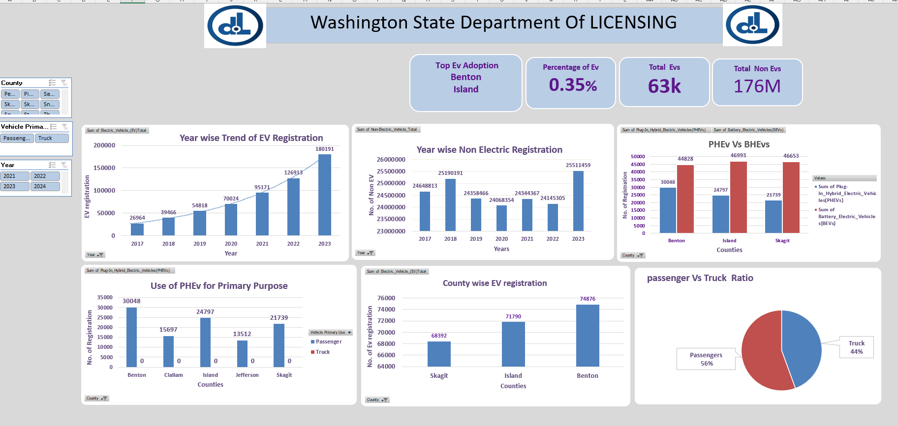

Slide 7
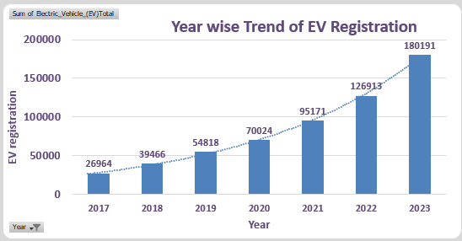
Significant Growth in EV Registrations

Slide 8
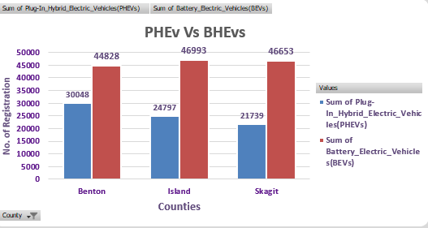
Comparative Analysis of Plug-In Hybrid Electric Vehicles (PHEVs) vs Battery Electric Vehicles (BEVs) Registrations by County

Slide 9
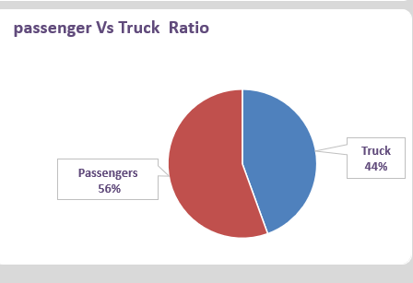
Ratio of passenger vs. trucks

Slide 10
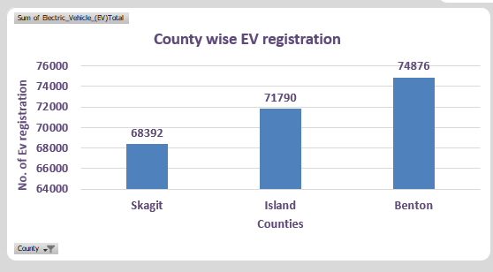
Top Counties in EV Adoption

Slide 11
Data Insights
1. Significant Growth in EV Registrations
EV registrations have shown dramatic growth from 26,964 in 2017 to 180,191 in 2023, marking a 568.24% increase over the 6-year period. This demonstrates a strong upward trend in EV adoption in Washington State.
2. Top Counties in EV Adoption
Certain counties have emerged as leaders in EV adoption.
Benton, Island, and Skagit counties lead in the number of EV registrations. These counties account for a large share of total registrations, highlighting the areas with the most significant EV adoption.
3. EV Growth Compared to Non-EV Vehicles
While EVs are growing rapidly, their share of total vehicle registrations remains relatively small, representing a significant opportunity for further market penetration and adoption.
4. Increasing Share of Passenger EVs
A majority of EVs in Washington State are being used as passenger vehicles, accounting for 56% of total EV registrations, while 44% are used for trucks. This suggests a balanced adoption across vehicle types, with passenger vehicles leading the way.

Slide 12
Recommendations
1. Expand Charging Infrastructure
Increase EV charging stations in rural areas to improve accessibility.
2. Offer Purchase Incentives
Extend financial subsidies and rebates to make EVs more affordable.
3. Launch Awareness Campaigns
Educate consumers in low-adoption areas about the benefits of EVs.
4. Support Both BEVs and PHEVs
Promote both battery electric and plug-in hybrid electric vehicles.
5. Strengthen Policies
Implement stronger EV-friendly regulations and incentives.
6. Focus on Urban EV Adoption
Encourage EV adoption in cities to reduce emissions.
7. Foster Industry Collaboration
Promote partnerships between automakers and charging network providers.

Slide 13
Future Scope
Integrate machine learning models to predict EV adoption rates.
Expand the analysis to include other states for broader comparisons.
Analyze the environmental impact of increasing EV adoption.
Tools & Technologies Used
Data Cleaning & Analysis: Microsoft Excel
Visualization: Excel Dashboard
Version Control: GitHub

